Slide 1




We came prepared today

Slide 2


This PPT has steps to interact with LLMs

Slide 3
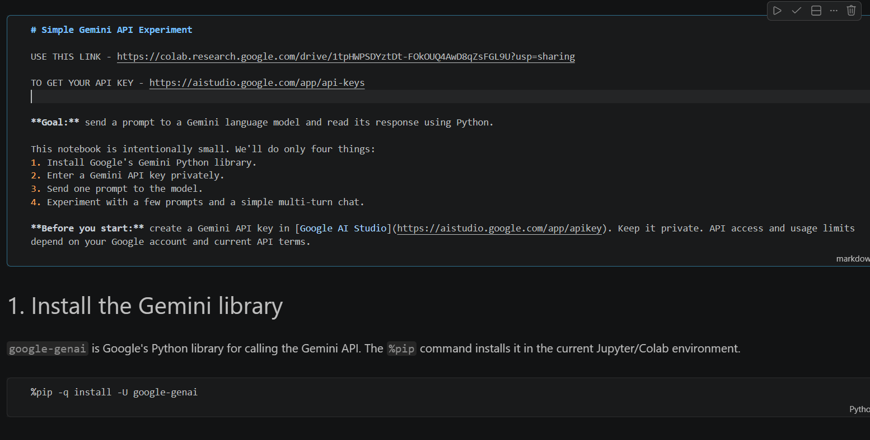


open your readme file and go to the first website to open collab a
use 2nd link to get
your API

Slide 4
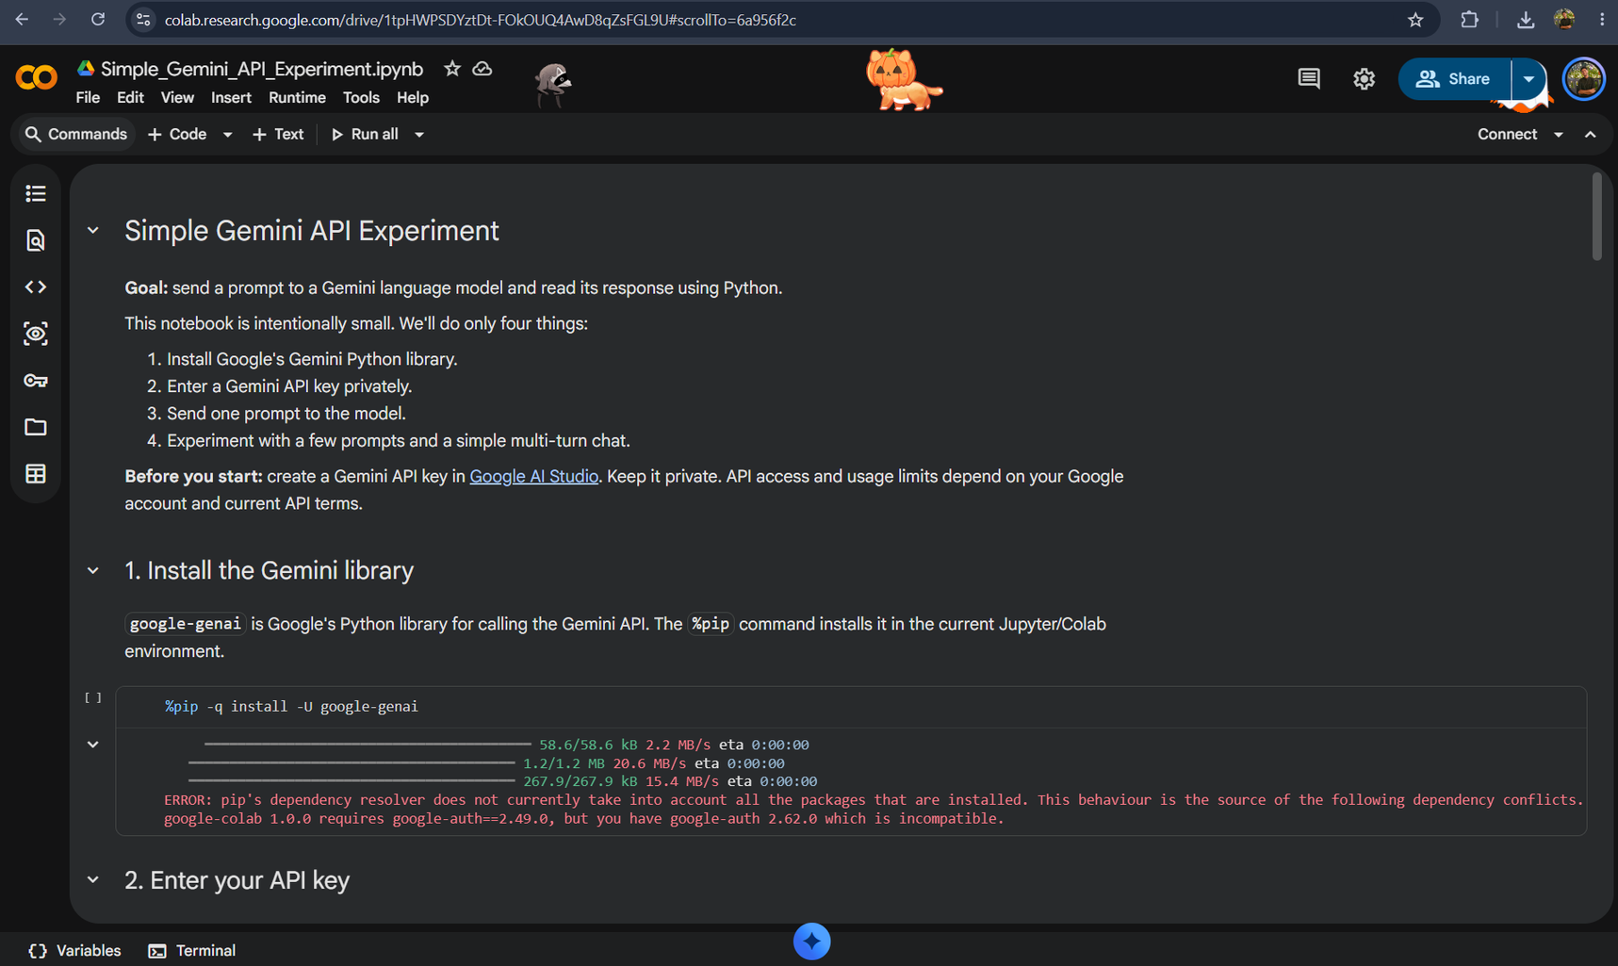

You will land here, this is goooogle collab

Slide 5
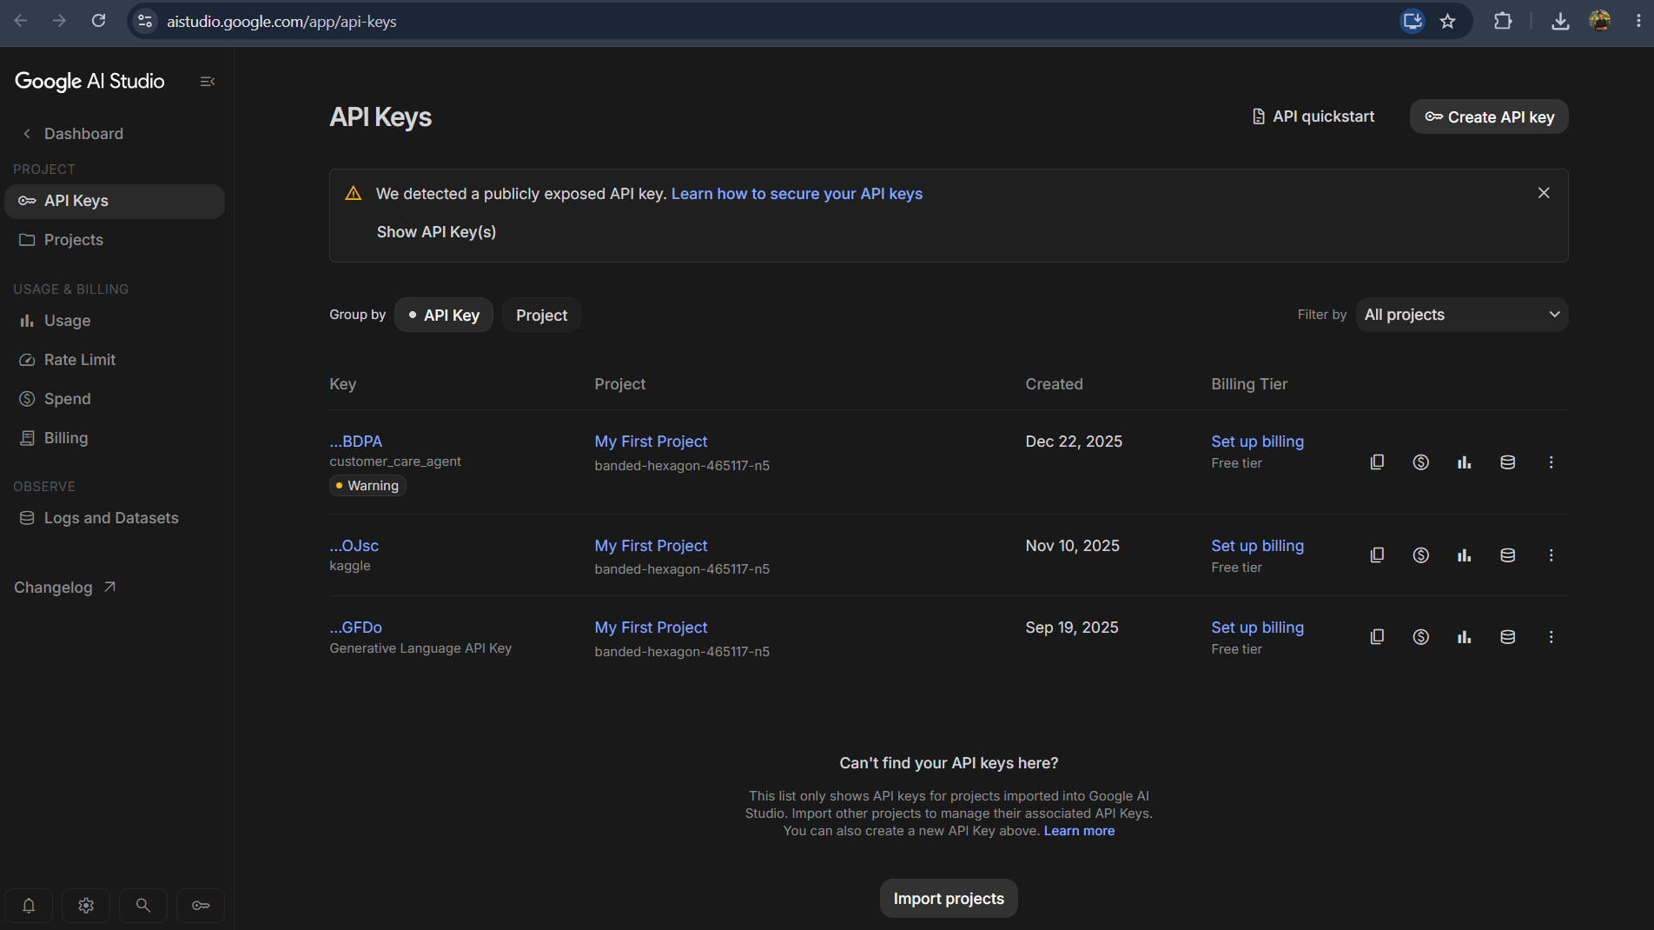

Sign In , create your own API key
and copy your API key

Slide 6
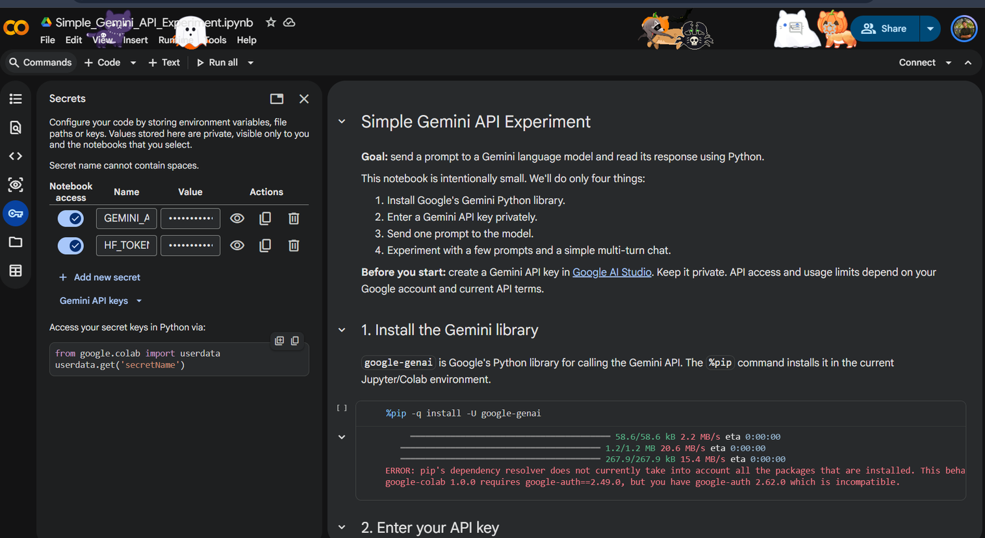


Set Your API Key
Click on add new secret
in “Name” type - “GEMINI_API_KEY”
and add ur API key in Value section and allow notebook access

Slide 7


Connect to T4

Slide 8

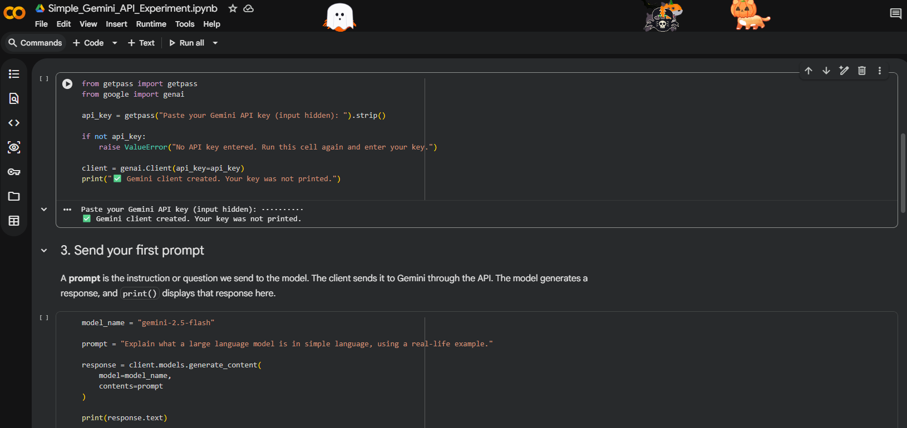
Run the cells

Slide 9

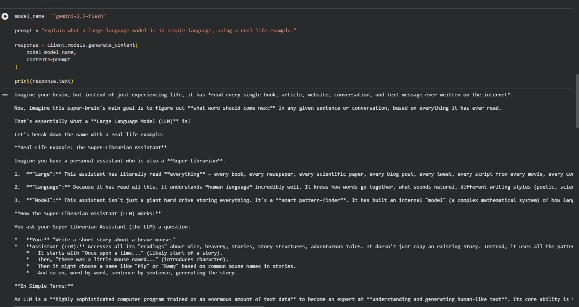

LLM output

Slide 10
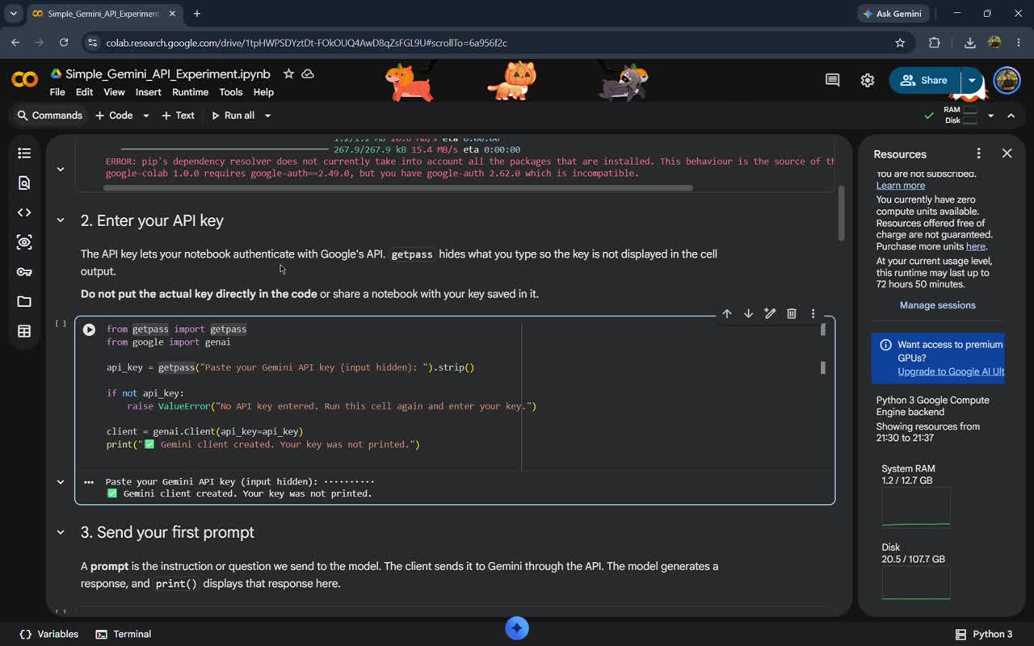
SOME FUN
Your paragraph text

Slide 11
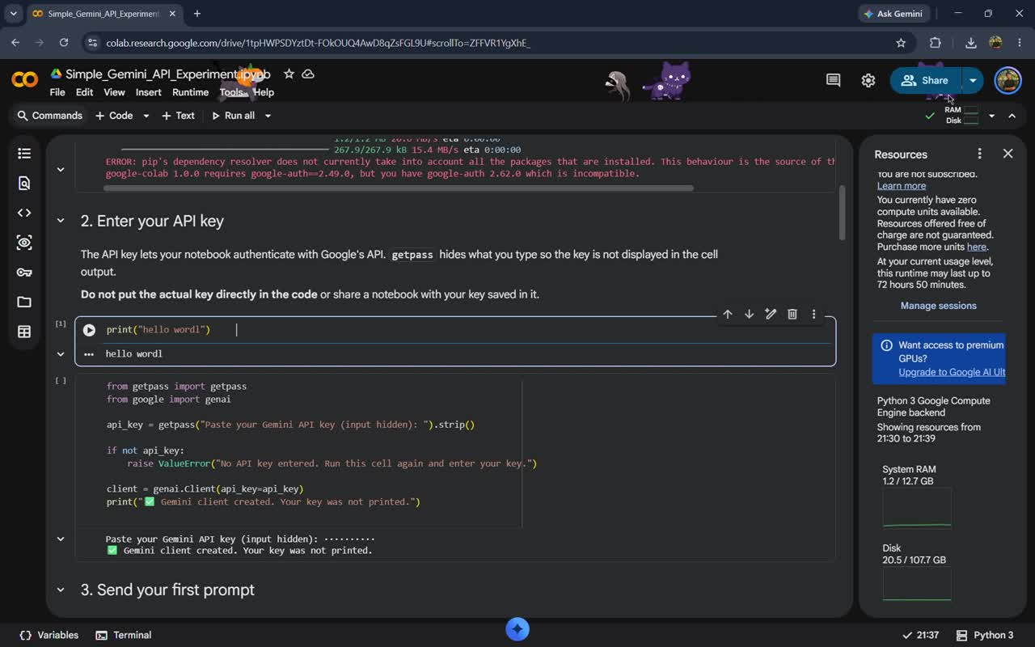
How can u do this

Slide 12

Thank You

